Slide 1
SQL
Topic 5
Readings:
Chapters 4 and 5
CS319

Slide 2
TOPICS
Basic Overview of SQL
Using MySQL
More SQL!
CS319

Slide 3
Running MySQL on Ubuntu
Starting it and creating a database
MySQL commands:
From Virtual Machine to
get into mysql:
  mysql –u root –ppassword
Commands once you are in:
  show databases;
  drop database if exists vetdb;
  create database vetdb;
  use vetdb;
  show tables;
NOTES – MySQL commands:
  show lists all databases
  drop deletes a database
  create creates a database
  use allows you to start using a database
  Commands are case insensitive, table names/attribute names are case sensitive!
CS3319

Slide 4
SQL (Structured Query Language) Overview
SQL comprehensive language that is both a DDL and a DML (it creates the database and allows manipulation of the database)
The statement to create the database initially is CREATE DATABASE whateverdbname
NOTE: You should only have to do once to create the database.
We will walk through an actual example from MySQL to illustrate the basic SQL commands.
CS319

Slide 5
Data Types in MySQL
http://www.w3resource.com/mysql/mysql-data-types.php
CS319

Slide 6
Basic SQL Commands:
Creating Tables:
CREATE TABLE TableName (Attr1 type NOT NULL, Attr2 type, Attr3 type, PRIMARY KEY (Attr1)) ;
Example:
CREATE TABLE owner (firstname VARCHAR(20), lastname VARCHAR(20), ownerid INT NOT NULL, PRIMARY KEY (ownerid));
CS319

Slide 7
Inserting Data Into Tables:
INSERT INTO TableName (Attr1Name, Attr2Name, Attr3Name) VALUES (value1, value2, value3);
OR
INSERT INTO TableName VALUES (value1, value2, value3);
NOTE: if you use this method you must put a value for EVERY field and in the correct order that the fields are in the table
Example:
INSERT INTO owner (firstname, lastname, ownerid) VALUES ("Laura","Reid",1);
CS319

Slide 8
Updating Existing Data:
UPDATE TableName SET AttrName = 'Value' WHERE Condition;
Example:
UPDATE owner SET firstname=“Elaine” WHERE firstname =“Laura”;
CS319

Slide 9

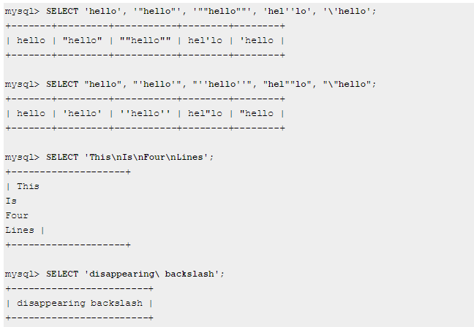
Examples using Quotes:
CS3319

Slide 10
Deleting Tuples From Tables:
DELETE FROM TableName WHERE Condition
Example:
DELETE FROM owner WHERE lastname =‘Reid‘;
CS319

Slide 11
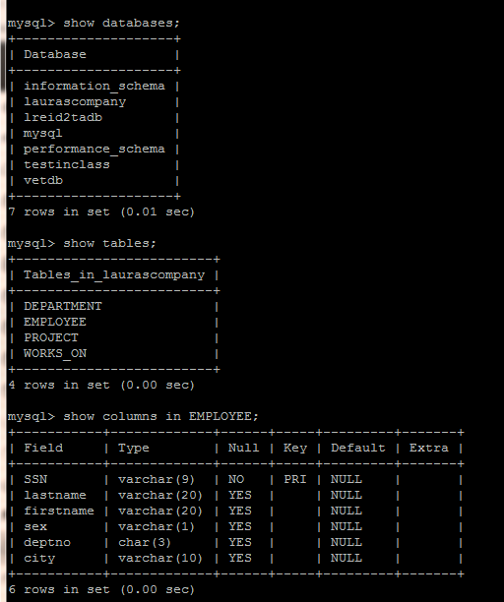
Getting information back (if you can’t remember table names or column names)
show databases;
show tables;
show columns in tablename;
e.g. show columns in EMPLOYEE;
CS319

Slide 12
Basic Queries:
SELECT AttrName[, AttrName] FROM TableName[,TableName] WHERE Condition;
Example:
SELECT name FROM pet WHERE species =“Dog”;
or
SELECT * FROM pet, owner WHERE pet.ownerid=owner.ownerid;
(this is a join)
CS319

Slide 13
Creating Views:
CREATE VIEW ViewName AS SELECT AttrName[, AttrName] FROM TableName[,TableName] WHERE Condition;
Example:
create view ownersandpets as select firstname, lastname, name from pet, owner where owner.ownerid=pet.ownerid;
select * from ownersandpets;
QUESTION: What is a view and why do we need views?
CS319

Slide 14
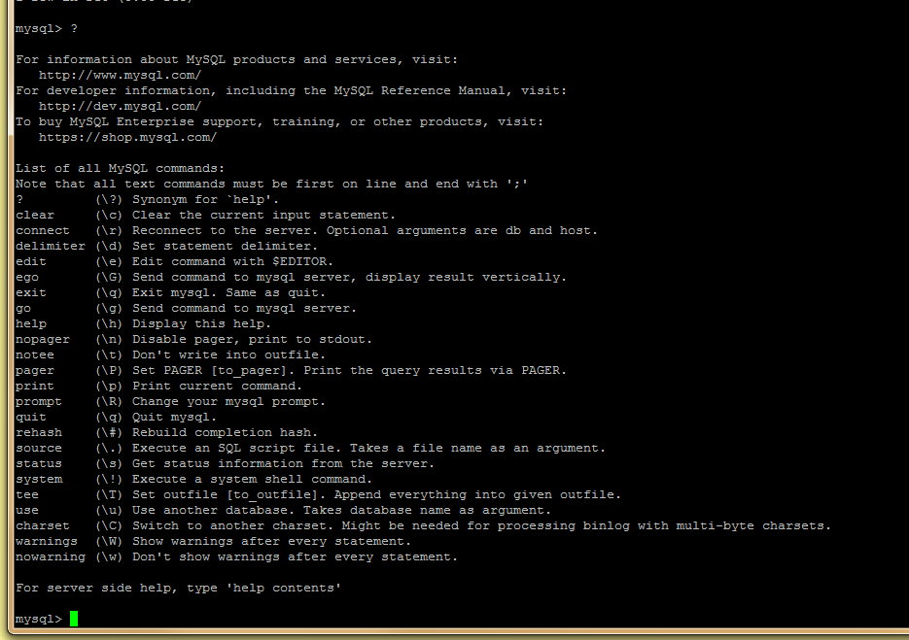
Need Help
Type ?
CS3319

Slide 15
Example – Step 1→ create your Database and Tables
Connect to your virtual machine and lets set up the employee, department, project, workson database:
http://www.csd.uwo.ca/~lreid/cs3319/sqlscripts/
CS3319

Slide 16
create database mycompany;
use mycompany;
CREATE TABLE department (
deptno CHAR(3),
deptname VARCHAR(20),
deptlocation VARCHAR(20),
primary key (deptno)
);
CREATE TABLE project (
projectid VARCHAR(3),
projectname VARCHAR(20),
projectlocation VARCHAR(20),
deptno CHAR(3),
PRIMARY KEY (projectid),
FOREIGN KEY (deptno)
REFERENCES department (deptno)
);
CS3319

Slide 17
CREATE TABLE employee (
SSN VARCHAR(9) NOT NULL,
lastname VARCHAR(20),
firstname VARCHAR(20),
sex CHAR(1),
deptno CHAR(3),
PRIMARY KEY (SSN),
FOREIGN KEY (deptno)
REFERENCES department (deptno)
);
CREATE TABLE workson (
SSN VARCHAR(9),
projectid VARCHAR(3),
hours INT,
PRIMARY KEY (SSN , projectid),
FOREIGN KEY (SSN)
REFERENCES employee (SSN),
FOREIGN KEY (projectid)
REFERENCES project (projectid)
);
CS3319

Slide 18
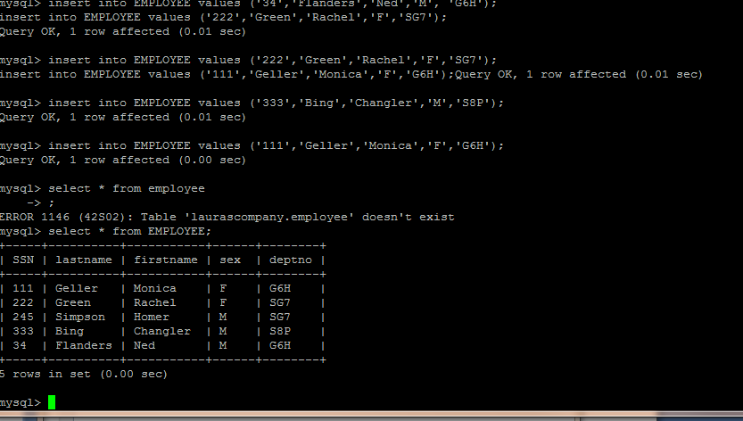
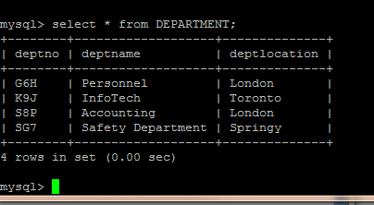
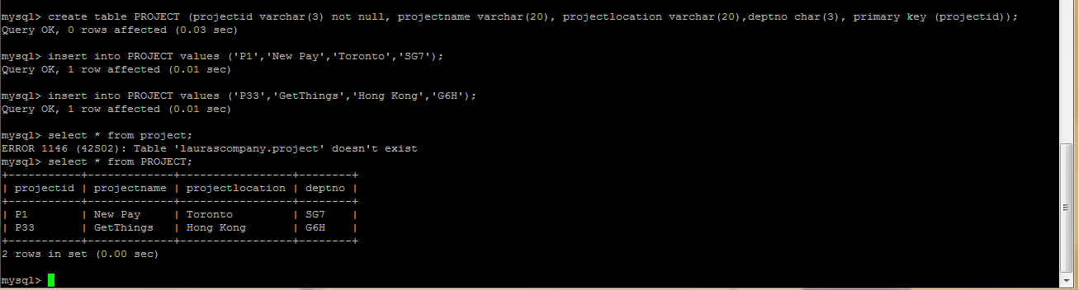
Step 2: Put some data into your tables
CS319

Slide 19
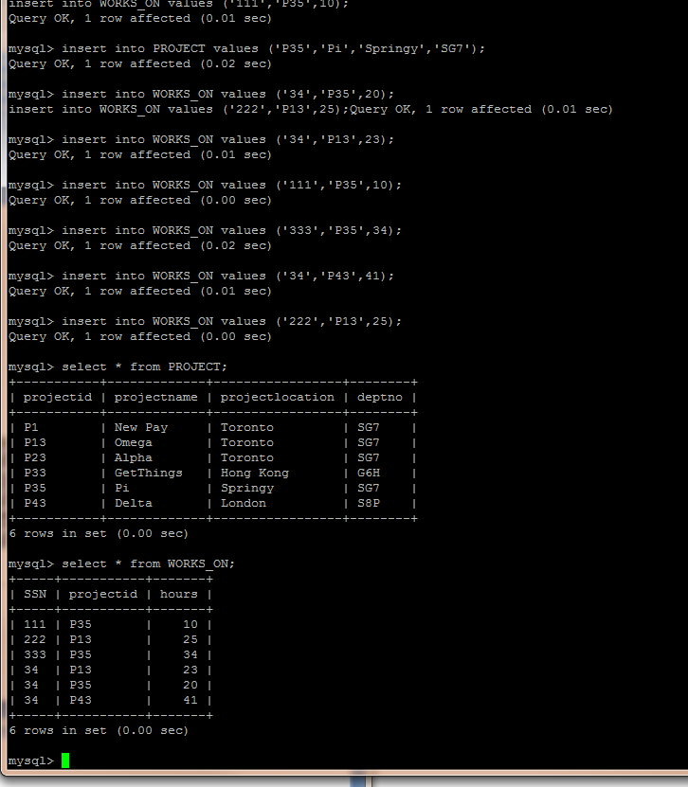
CS319

Slide 20
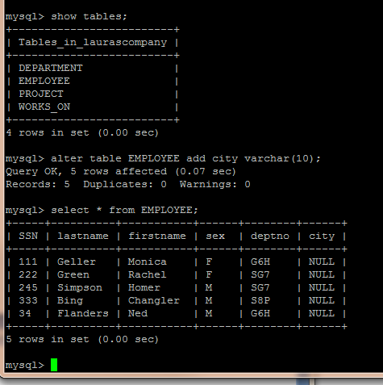
CS319

Slide 21
http://www.csd.uwo.ca/~lreid/cs3319/sqlscripts/insertingexample.txt
use mycompany;
insert into department values("G8H","Personnel","London");
insert into department values("K9J","InfoTech","Toronto");
insert into department values("S8P","Accounting","London");
insert into department values("SG7","Safety Department","Springy");
insert into employee values("111","Geller","Monica","F","G8H");
insert into employee values("222","Green","Rachel","F","SG7");
insert into employee values("245","Simpson","Homer","M","SG7");
insert into employee values("333","Bing","Changler","M","S8P");
insert into employee values("34","Flanders","Ned","M","G8H");
insert into project values ("P1", "New Pay", "Toronto", "SG7");
insert into project values ("P13", "Omega", "Toronto", "SG7");
insert into project values ("P23", "Alpha", "Toronto", "SG7");
insert into project values ("P33", "GetThings", "Hong Kong", "G8H");
insert into project values ("P35", "Pi", "Springy", "SG7");
insert into project values ("P43", "Delta", "London", "S8P");
insert into workson values ("111","P35",10);
insert into workson values ("222","P13",25);
insert into workson values ("333","P35",34);
insert into workson values ("34","P13",23);
insert into workson values ("34","P35",20);
insert into workson values ("34","P43",41);
CS3319

Slide 22
Step 3: Do Some Queries using SQL
Projection:
select attribute1, attribute2 from tablename;
e.g. select firstname, lastname from employee;
+-----+----------+-----------+------+--------+
| SSN | lastname | firstname | sex | deptno |
+-----+----------+-----------+------+--------+
| 111 | Geller | Monica | F | G8H |
| 222 | Green | Rachel | F | SG7 |
| 245 | Simpson | Homer | M | SG7 |
| 333 | Bing | Changler | M | S8P |
| 34 | Flanders | Ned | M | G8H |
+-----+----------+-----------+------+--------+
5 rows in set (0.00 sec)
CS319

Slide 23
Question: What do you think:
select distinct lastname from employee;
does?
mysql> select sex from employee;
+------+
| sex |
+------+
| F |
| F |
| M |
| M |
| M |
+------+
5 rows in set (0.00 sec)
mysql> select distinct sex from employee;
+------+
| sex |
+------+
| F |
| M |
+------+
2 rows in set (0.00 sec)
CS319

Slide 24
Selection:
select * from tablename where condition; (* gives all fields)
e.g.
select * from employee where sex=“F”;
select firstname, lastname from employee where sex=‘F’;
mysql> select * from employee where sex="F";
+-----+----------+-----------+------+--------+
| SSN | lastname | firstname | sex | deptno |
+-----+----------+-----------+------+--------+
| 111 | Geller | Monica | F | G8H |
| 222 | Green | Rachel | F | SG7 |
+-----+----------+-----------+------+--------+
2 rows in set (0.00 sec)
mysql> select firstname,lastname from employee where sex="F";
+-----------+----------+
| firstname | lastname |
+-----------+----------+
| Monica | Geller |
| Rachel | Green |
+-----------+----------+
2 rows in set (0.00 sec)
CS319

Slide 25
select * from EMPLOYEE where city is null and sex=“F”;
+-----+----------+-----------+------+--------+------+
| SSN | lastname | firstname | sex | deptno | city |
+-----+----------+-----------+------+--------+------+
| 111 | Geller | Monica | F | G6H | NULL |
| 222 | Green | Rachel | F | SG7 | NULL |
+-----+----------+-----------+------+--------+------+
2 rows in set (0.00 sec)
5 record(s) selected.
select * from EMPLOYEE order by firstname;
+-----+----------+-----------+------+--------+------+
| SSN | lastname | firstname | sex | deptno | city |
+-----+----------+-----------+------+--------+------+
| 333 | Bing | Changler | M | S8P | NULL |
| 245 | Simpson | Homer | M | SG7 | NULL |
| 111 | Geller | Monica | F | G6H | NULL |
| 34 | Flanders | Ned | M | G6H | NULL |
| 222 | Green | Rachel | F | SG7 | NULL |
+-----+----------+-----------+------+--------+------+
5 rows in set (0.00 sec)
CS319

Slide 26
select count(*) from EMPLOYEE;
+----------+
| count(*) |
+----------+
| 5 |
+----------+
select count(sex) from EMPLOYEE;
+------------+
| count(sex) |
+------------+
| 5 |
+------------+
select count(distinct sex) from EMPLOYEE;
+---------------------+
| count(distinct sex) |
+---------------------+
| 2 |
+---------------------+
1 row in set (0.00 sec)
CS319

Slide 27
select * from WORKS_ON;
+-----+-----------+-------+
| SSN | projectid | hours |
+-----+-----------+-------+
| 111 | P35 | 10 |
| 222 | P13 | 25 |
| 333 | P35 | 34 |
| 34 | P13 | 23 |
| 34 | P35 | 20 |
| 34 | P43 | 41 |
+-----+-----------+-------+
6 rows in set (0.00 sec)
select ssn from WORKS_ON where hours > 25;
+-----+
| ssn |
+-----+
| 333 |
| 34 |
+-----+
2 rows in set (0.00 sec)
select * from WORKS_ON where projectid = 'P35' and hours > 20;
+-----+-----------+-------+
| SSN | projectid | hours |
+-----+-----------+-------+
| 333 | P35 | 34 |
+-----+-----------+-------+
1 row in set (0.00 sec)
CS319

Slide 28
mysql>select * from EMPLOYEE;
+-----+----------+-----------+------+--------+------+
| SSN | lastname | firstname | sex | deptno | city |
+-----+----------+-----------+------+--------+------+
| 111 | Geller | Monica | F | G6H | NULL |
| 222 | Green | Rachel | F | SG7 | NULL |
| 245 | Simpson | Homer | M | SG7 | NULL |
| 333 | Bing | Changler | M | S8P | NULL |
| 34 | Flanders | Ned | M | G6H | NULL |
+-----+----------+-----------+------+--------+------+
5 rows in set (0.00 sec)
mysql> select count(*) from EMPLOYEE;
+----------+
| count(*) |
+----------+
| 5 |
+----------+
1 row in set (0.00 sec)
mysql> select deptno, count(*) from EMPLOYEE group by deptno;
+--------+----------+
| deptno | count(*) |
+--------+----------+
| G6H | 2 |
| S8P | 1 |
| SG7 | 2 |
+--------+----------+
3 rows in set (0.00 sec)
CS3319

Slide 29
Cartesian Product:
mysql> select * from employee, department;
+-----+----------+-----------+------+--------+--------+-------------------+--------------+
| SSN | lastname | firstname | sex | deptno | deptno | deptname | deptlocation |
+-----+----------+-----------+------+--------+--------+-------------------+--------------+
| 111 | Geller | Monica | F | G8H | G8H | Personnel | London |
| 111 | Geller | Monica | F | G8H | K9J | InfoTech | Toronto |
| 111 | Geller | Monica | F | G8H | S8P | Accounting | London |
| 111 | Geller | Monica | F | G8H | SG7 | Safety Department | Springy |
| 222 | Green | Rachel | F | SG7 | G8H | Personnel | London |
| 222 | Green | Rachel | F | SG7 | K9J | InfoTech | Toronto |
| 222 | Green | Rachel | F | SG7 | S8P | Accounting | London |
| 222 | Green | Rachel | F | SG7 | SG7 | Safety Department | Springy |
| 245 | Simpson | Homer | M | SG7 | G8H | Personnel | London |
| 245 | Simpson | Homer | M | SG7 | K9J | InfoTech | Toronto |
| 245 | Simpson | Homer | M | SG7 | S8P | Accounting | London |
| 245 | Simpson | Homer | M | SG7 | SG7 | Safety Department | Springy |
| 333 | Bing | Changler | M | S8P | G8H | Personnel | London |
| 333 | Bing | Changler | M | S8P | K9J | InfoTech | Toronto |
| 333 | Bing | Changler | M | S8P | S8P | Accounting | London |
| 333 | Bing | Changler | M | S8P | SG7 | Safety Department | Springy |
| 34 | Flanders | Ned | M | G8H | G8H | Personnel | London |
| 34 | Flanders | Ned | M | G8H | K9J | InfoTech | Toronto |
| 34 | Flanders | Ned | M | G8H | S8P | Accounting | London |
| 34 | Flanders | Ned | M | G8H | SG7 | Safety Department | Springy |
+-----+----------+-----------+------+--------+--------+-------------------+--------------+
20 rows in set (0.00 sec)
CS319

Slide 30
Joins:
mysql> show tables;
+---------------------+
| Tables_in_mycompany |
+---------------------+
| department |
| employee |
| project |
| workson |
+---------------------+
4 rows in set (0.00 sec)
mysql> select * from employee;
+-----+----------+-----------+------+--------+
| SSN | lastname | firstname | sex | deptno |
+-----+----------+-----------+------+--------+
| 111 | Geller | Monica | F | G8H |
| 222 | Green | Rachel | F | SG7 |
| 245 | Simpson | Homer | M | SG7 |
| 333 | Bing | Changler | M | S8P |
| 34 | Flanders | Ned | M | G8H |
+-----+----------+-----------+------+--------+
5 rows in set (0.00 sec)
CS319

Slide 31
mysql> select * from department;
+--------+-------------------+--------------+
| deptno | deptname | deptlocation |
+--------+-------------------+--------------+
| G8H | Personnel | London |
| K9J | InfoTech | Toronto |
| S8P | Accounting | London |
| SG7 | Safety Department | Springy |
+--------+-------------------+--------------+
4 rows in set (0.00 sec)
mysql> select lastname from employee where deptno = "SG7";
+----------+
| lastname |
+----------+
| Green |
| Simpson |
+----------+
2 rows in set (0.00 sec)
mysql> select deptname from department;
+-------------------+
| deptname |
+-------------------+
| Personnel |
| InfoTech |
| Accounting |
| Safety Department |
+-------------------+
4 rows in set (0.00 sec)
CS319

Slide 32
mysql> select deptname from department where deptno="SG7";
+-------------------+
| deptname |
+-------------------+
| Safety Department |
+-------------------+
1 row in set (0.00 sec)
mysql> select lastname from employee where deptno in (Select deptno from department where deptname="Safety Department");
+----------+
| lastname |
+----------+
| Green |
| Simpson |
+----------+
2 rows in set (0.00 sec)
mysql> select lastname from employee, department where employee.deptno=department.deptno and department.deptname="Safety Department";
+----------+
| lastname |
+----------+
| Green |
| Simpson |
+----------+
2 rows in set (0.00 sec)
CS319

Slide 33
mysql> select * from employee right outer join department on employee.deptno=department.deptno;
+------+----------+-----------+------+--------+--------+-------------------+--------------+
| SSN | lastname | firstname | sex | deptno | deptno | deptname | deptlocation |
+------+----------+-----------+------+--------+--------+-------------------+--------------+
| 111 | Geller | Monica | F | G8H | G8H | Personnel | London |
| 34 | Flanders | Ned | M | G8H | G8H | Personnel | London |
| NULL | NULL | NULL | NULL | NULL | K9J | InfoTech | Toronto |
| 333 | Bing | Changler | M | S8P | S8P | Accounting | London |
| 222 | Green | Rachel | F | SG7 | SG7 | Safety Department | Springy |
| 245 | Simpson | Homer | M | SG7 | SG7 | Safety Department | Springy |
+------+----------+-----------+------+--------+--------+-------------------+--------------+
6 rows in set (0.00 sec)
NOTE: Full outer join would be: SELECT * FROM EMPLOYEE FULL JOIN DEPARTMENT ON DEPARTMENT.DEPTNO = EMPLOYEE.DEPTNO
CS319

Slide 34
Union:
First, let’s add a city column to the employee table:
mysql> alter table employee add city varchar(20);
Query OK, 5 rows affected (0.18 sec)
Records: 5 Duplicates: 0 Warnings: 0mysql> select * from employee;
+-----+----------+-----------+------+--------+------+
| SSN | lastname | firstname | sex | deptno | city |
+-----+----------+-----------+------+--------+------+
| 111 | Geller | Monica | F | G8H | NULL |
| 222 | Green | Rachel | F | SG7 | NULL |
| 245 | Simpson | Homer | M | SG7 | NULL |
| 333 | Bing | Changler | M | S8P | NULL |
| 34 | Flanders | Ned | M | G8H | NULL |
+-----+----------+-----------+------+--------+------+
5 rows in set (0.00 sec)
mysql> update employee set city="Calgary" where sex="F";
Query OK, 2 rows affected (0.00 sec)
Rows matched: 2 Changed: 2 Warnings: 0
mysql> update employee set city="Halifax" where sex="M";
Query OK, 3 rows affected (0.01 sec)
Rows matched: 3 Changed: 3 Warnings: 0
CS319

Slide 35
mysql> select * from department;
+--------+-------------------+--------------+
| deptno | deptname | deptlocation |
+--------+-------------------+--------------+
| G8H | Personnel | London |
| K9J | InfoTech | Toronto |
| S8P | Accounting | London |
| SG7 | Safety Department | Springy |
+--------+-------------------+--------------+
4 rows in set (0.00 sec)
mysql> select deptlocation from department union (select city from employee);
+--------------+
| deptlocation |
+--------------+
| London |
| Toronto |
| Springy |
| Calgary |
| Halifax |
+--------------+
5 rows in set (0.00 sec)
CS319

Slide 36
Intersection:
mysql> select deptlocation from department;
+--------------+
| deptlocation |
+--------------+
| London |
| Toronto |
| London |
| Springy |
+--------------+
4 rows in set (0.00 sec)
mysql> select projectlocation from project;
+----------------+
| projectlocation |
+----------------+
| Toronto |
| Toronto |
| Toronto |
| Hong Kong |
| Springy |
| London |
+----------------+
6 rows in set (0.00 sec)
mysql> select distinct department.deptlocation from department join project on project.projectlocation=department.deptlocation;
+--------------+
| deptlocation |
+--------------+
| Toronto |
| Springy |
| London |
+--------------+
3 rows in set (0.00 sec)
CS319

Slide 37
Difference:
mysql> select deptlocation from department;
+--------------+
| deptlocation |
+--------------+
| London |
| Toronto |
| London |
| Springy |
+--------------+
4 rows in set (0.00 sec)
mysql> select projectlocation from project;
+----------------+
| projectlocation |
+----------------+
| Toronto |
| Toronto |
| Toronto |
| Hong Kong |
| Springy |
| London |
+----------------+
6 rows in set (0.00 sec)
mysql> select projectlocation from project where projectlocation not in (select deptlocation from department);
+----------------+
| projectlocation |
+----------------+
| Hong Kong |
+----------------+
1 row in set (0.00 sec)
CS319

Slide 38
Wildcards/Pattern Matching:
mysql> select * from project where projectlocation like '%on%';
+-----------+-------------+----------------+--------+
| projectid | projectname | projectlocation | deptno |
+-----------+-------------+----------------+--------+
| P1 | New Pay | Toronto | SG7 |
| P13 | Omega | Toronto | SG7 |
| P23 | Alpha | Toronto | SG7 |
| P33 | GetThings | Hong Kong | G8H |
| P43 | Delta | London | S8P |
+-----------+-------------+----------------+--------+
5 rows in set (0.00 sec)
mysql> select * from project where projectid like 'P_3';
+-----------+-------------+----------------+--------+
| projectid | projectname | projectlocation | deptno |
+-----------+-------------+----------------+--------+
| P13 | Omega | Toronto | SG7 |
| P23 | Alpha | Toronto | SG7 |
| P33 | GetThings | Hong Kong | G8H |
| P43 | Delta | London | S8P |
+-----------+-------------+----------------+--------+
4 rows in set (0.00 sec)
CS319

Slide 39
Updating Records
mysql> update employee set city ="Montreal";
Query OK, 5 rows affected (0.01 sec)
Rows matched: 5 Changed: 5 Warnings: 0
mysql> select * from employee;
+-----+----------+-----------+------+--------+----------+
| SSN | lastname | firstname | sex | deptno | city |
+-----+----------+-----------+------+--------+----------+
| 111 | Geller | Monica | F | G8H | Montreal |
| 222 | Green | Rachel | F | SG7 | Montreal |
| 245 | Simpson | Homer | M | SG7 | Montreal |
| 333 | Bing | Changler | M | S8P | Montreal |
| 34 | Flanders | Ned | M | G8H | Montreal |
+-----+----------+-----------+------+--------+----------+
5 rows in set (0.00 sec)
mysql> update employee set city="Abu Dhabi" where sex="F";
Query OK, 2 rows affected (0.00 sec)
Rows matched: 2 Changed: 2 Warnings: 0
mysql> select * from employee;
+-----+----------+-----------+------+--------+-----------+
| SSN | lastname | firstname | sex | deptno | city |
+-----+----------+-----------+------+--------+-----------+
| 111 | Geller | Monica | F | G8H | Abu Dhabi |
| 222 | Green | Rachel | F | SG7 | Abu Dhabi |
| 245 | Simpson | Homer | M | SG7 | Montreal |
| 333 | Bing | Changler | M | S8P | Montreal |
| 34 | Flanders | Ned | M | G8H | Montreal |
+-----+----------+-----------+------+--------+-----------+
5 rows in set (0.00 sec)
CS319

Slide 40
Deleting Records:
mysql> select * from employee;
+-----+----------+-----------+------+--------+-----------+
| SSN | lastname | firstname | sex | deptno | city |
+-----+----------+-----------+------+--------+-----------+
| 111 | Geller | Monica | F | G8H | Abu Dhabi |
| 222 | Green | Rachel | F | SG7 | Abu Dhabi |
| 245 | Simpson | Homer | M | SG7 | Montreal |
| 333 | Bing | Changler | M | S8P | Montreal |
| 34 | Flanders | Ned | M | G8H | Montreal |
+-----+----------+-----------+------+--------+-----------+
5 rows in set (0.00 sec)
mysql> delete from employee where firstname like "N%";
ERROR 1451 (23000): Cannot delete or update a parent row: a foreign key constraint fails (`mycompany`.`workson`, CONSTRAINT `workson_ibfk_1` FOREIGN KEY (`SSN`) REFERENCES `employee` (`SSN`))
mysql> select * from workson;
+-----+-----------+-------+
| SSN | projectid | hours |
+-----+-----------+-------+
| 222 | P13 | 25 |
| 333 | P35 | 34 |
| 34 | P13 | 23 |
| 34 | P35 | 20 |
| 34 | P43 | 41 |
+-----+-----------+-------+
5 rows in set (0.00 sec)
mysql> delete from employee where firstname like "M%";
Query OK, 1 row affected (0.02 sec)
CS319

Slide 41
Step 4: Adding, Fixing, Deleting Tables
mysql> create table petowner (ownerid char(3), firstname varchar(20), lastname varchar(20), primary key(ownerid));
Query OK, 0 rows affected (0.03 sec)
mysql> insert into petowner values (222,"Peter","Griffin");
Query OK, 1 row affected (0.01 sec)
mysql> select * from petowner;
+---------+-----------+----------+
| ownerid | firstname | lastname |
+---------+-----------+----------+
| 222 | Peter | Griffin |
+---------+-----------+----------+
1 row in set (0.00 sec)
mysql> alter table petowner add address varchar(30);
Query OK, 1 row affected (0.04 sec)
Records: 1 Duplicates: 0 Warnings: 0
mysql> select * from petowner;
+---------+-----------+----------+---------+
| ownerid | firstname | lastname | address |
+---------+-----------+----------+---------+
| 222 | Peter | Griffin | NULL |
+---------+-----------+----------+---------+
1 row in set (0.00 sec)
mysql> alter table petowner drop column address;
Query OK, 1 row affected (0.06 sec)
Records: 1 Duplicates: 0 Warnings: 0
mysql> drop table petowner;
Query OK, 0 rows affected (0.02 sec)
CS319

Slide 42
Step 5: Building Constraints – NOTE: Check constraints don’t work in MySQL
db2 => list tables
NAME CREATOR TYPE CTIME
--------- ------ ---- --------------------------
DEPARTMENT LREID T 1998-05-16-23.16.11.502134
EMPLOYEE LREID T 1998-05-16-23.14.20.406159
PROJECT LREID T 1998-05-16-23.31.01.967801
PROJEMP LREID T 1998-05-16-23.32.55.432516
4 record(s) selected.
db2 => alter table projemp add constraint hourly check (hours > 0)
DB20000I The SQL command completed successfully.
db2 => select * from projemp
SSN PROJECTID HOURS
---- --------- -----------
34 P35 20
34 P13 23
111 P35 10
333 P35 34
34 P43 41
222 P13 25
6 record(s) selected.
CS319

Slide 43
db2 => update projemp set hours = 8 where ssn='222'
DB20000I The SQL command completed successfully.
db2 => select * from projemp
SSN PROJECTID HOURS
--- --------- -----------
34 P35 20
34 P13 23
111 P35 10
333 P35 34
34 P43 41
222 P13 8
6 record(s) selected.
db2 => update projemp set hours = -3 where ssn='222'
DB21034E The command was processed as an SQL statement because it was not a valid Command Line Processor command. During SQL processing it returned:
SQL0545N The requested operation is not allowed because a row does not satisfy the check constraint "LREID.PROJEMP.HOURY". SQLSTATE=23513
CS319

Slide 44
db2 => alter table employee add constraint deptvalid foreign key(deptno) \
db2 (cont.) => references department on delete set null
DB20000I The SQL command completed successfully.
db2 => select * from employee
SSN LASTNAME FIRSTNAME SEX DEPTNO CITY
--- -------- --------- --- ------ ----------
245 Simpson Homer M SG7 Montreal
222 Green Rachel F SG7 Abu Dhabi
333 Bing Chandler M S8P Montreal
111 Geller Monica F G6H Abu Dhabi
4 record(s) selected.
db2 => select * from department
DEPTNO DEPTNAME LOCATION
------ ----------------- ----------
SG7 Safety Department Springy
S8P Accounting London
G6H Personnel London
K9J InfoTech Toronto
4 record(s) selected.
CS319

Slide 45
db2 => delete from department where deptno = 'G6H'
DB20000I The SQL command completed successfully.
db2 => select * from employee
SSN LASTNAME FIRSTNAME SEX DEPTNO CITY
--- -------- --------- --- ------ ----------
245 Simpson Homer M SG7 Montreal
222 Green Rachel F SG7 Abu Dhabi
333 Bing Changler M S8P Montreal
111 Geller Monica F - Abu Dhabi
4 record(s) selected.
db2 => select lastname, firsname, deptname from department, employee \
db2 (cont.) => where department.deptno = employee.deptno
LASTNAME FIRSTNAME DEPTNAME
-------- --------- -----------------
Simpson Homer Safety Department
Green Rachel Safety Department
Bing Changler Accounting
3 record(s) selected.
CS319

Slide 46
Views
mysql> create view vdeptemp as select firstname, lastname, deptname from department, employee where department.deptno=employee.deptno;
Query OK, 0 rows affected (0.02 sec)
mysql> select * from vdeptemp;
+-----------+----------+-------------------+
| firstname | lastname | deptname |
+-----------+----------+-------------------+
| Rachel | Green | Safety Department |
| Homer | Simpson | Safety Department |
| Changler | Bing | Accounting |
| Ned | Flanders | Personnel |
+-----------+----------+-------------------+
4 rows in set (0.01 sec)
mysql> show tables;
+---------------------+
| Tables_in_mycompany |
+---------------------+
| department |
| employee |
| project |
| vdeptemp |
| workson |
+---------------------+
5 rows in set (0.00 sec)
CS319

Slide 47
Step 6: Building Indices
NOTES:
Indices are used to find a row quickly, without an index MySQL starts at the first first row and just searches row by row.
On a table of 1000 rows, an index will make it 100 times faster!
Most MySQL indexes are stored in B+ trees.
You can choose between B+ tree index or Hash index in mysql
Normally you create an index at the time of table creation: In MySQL if you put primary key(fieldname) when you create a table, you automatically create a primary clustered index on that key.
To create an index use this command:
alter table tablename add index (columnname);
To show the indices on a table use this command:
show index from tablename;
CS319

Slide 48
Example
mysql> show columns in employee;
+-----------+-------------+------+-----+---------+-------+
| Field | Type | Null | Key | Default | Extra |
+-----------+-------------+------+-----+---------+-------+
| SSN | varchar(9) | NO | PRI | NULL | |
| lastname | varchar(20) | YES | | NULL | |
| firstname | varchar(20) | YES | | NULL | |
| sex | char(1) | YES | | NULL | |
| deptno | char(3) | YES | MUL | NULL | |
| city | varchar(20) | YES | | NULL | |
+-----------+-------------+------+-----+---------+-------+
6 rows in set (0.00 sec)
mysql> show index from employee;
+----------+------------+----------+--------------+-------------+-----------+-------------+----------+--------+------+------------+---------+---------------+
| Table | Non_unique | Key_name | Seq_in_index | Column_name | Collation | Cardinality | Sub_part | Packed | Null | Index_type | Comment | Index_comment |
+----------+------------+----------+--------------+-------------+-----------+-------------+----------+--------+------+------------+---------+---------------+
| employee | 0 | PRIMARY | 1 | SSN | A | 4 | NULL | NULL | | BTREE | | |
| employee | 1 | deptno | 1 | deptno | A | 4 | NULL | NULL | YES | BTREE | | |
+----------+------------+----------+--------------+-------------+-----------+-------------+----------+--------+------+------------+---------+---------------+
2 rows in set (0.00 sec)
mysql> alter table employee add index (lastname);
Query OK, 0 rows affected (0.08 sec)
Records: 0 Duplicates: 0 Warnings: 0
mysql> show index from employee;
+----------+------------+----------+--------------+-------------+-----------+-------------+----------+--------+------+------------+---------+---------------+
| Table | Non_unique | Key_name | Seq_in_index | Column_name | Collation | Cardinality | Sub_part | Packed | Null | Index_type | Comment | Index_comment |
+----------+------------+----------+--------------+-------------+-----------+-------------+----------+--------+------+------------+---------+---------------+
| employee | 0 | PRIMARY | 1 | SSN | A | 4 | NULL | NULL | | BTREE | | |
| employee | 1 | deptno | 1 | deptno | A | 4 | NULL | NULL | YES | BTREE | | |
| employee | 1 | lastname | 1 | lastname | A | 4 | NULL | NULL | YES | BTREE | | |
+----------+------------+----------+--------------+-------------+-----------+-------------+----------+--------+------+------------+---------+---------------+
3 rows in set (0.00 sec)
CS3319

Slide 49
Other Useful SQL Commands
CS319

Slide 50
Tuple Variables and Aliases
Used for long tables or to change column names within the same table.
For example, consider this table:
create table emp (ssn char(3), name varchar(20), salary int, supervisorssn char(3), primary key (ssn), foreign key (supervisorssn) references emp(ssn));
mysql> select * from emp;
+-----+-----------------+--------+---------------+
| ssn | name | salary | supervisorssn |
+-----+-----------------+--------+---------------+
| 333 | Homer Simpson | 40000 | 666 |
| 444 | Monty Burns | 100000 | NULL |
| 555 | Carl Friend | 50000 | 666 |
| 666 | Waylan Smithers | 45000 | 444 |
| 777 | Lisa Simpson | 20000 | 666 |
+-----+-----------------+--------+---------------+
5 rows in set (0.00 sec)
NOW do this query in sql:
Find all employee bosses and their workers.
CS319

Slide 51
mysql> select * from emp;
+-----+-----------------+--------+---------------+
| ssn | name | salary | supervisorssn |
+-----+-----------------+--------+---------------+
| 333 | Homer Simpson | 40000 | 666 |
| 444 | Monty Burns | 100000 | NULL |
| 555 | Carl Friend | 50000 | 666 |
| 666 | Waylan Smithers | 45000 | 444 |
| 777 | Lisa Simpson | 20000 | 666 |
+-----+-----------------+--------+---------------+
5 rows in set (0.00 sec)
mysql> select e.name as "Supervisor Name", e2.name as "Employee Name" from emp e, emp e2 where e.ssn=e2.supervisorssn;
+-----------------+-----------------+
| Supervisor Name | Employee Name |
+-----------------+-----------------+
| Waylan Smithers | Homer Simpson |
| Waylan Smithers | Carl Friend |
| Monty Burns | Waylan Smithers |
| Waylan Smithers | Lisa Simpson |
+-----------------+-----------------+
4 rows in set (0.00 sec)
CS3319

Slide 52
More on Nested SQL Queries
The predicate part of the where clause can contain a nested SQL query, connected to the main query by things like =, <>, >= and then the words SOME, ANY or ALL
Query: Find the employee who makes the greatest salary.
Example:
mysql> select name,salary from emp where salary = (select max(salary) from emp);
+-------------+--------+
| name | salary |
+-------------+--------+
| Monty Burns | 100000 |
+-------------+--------+
1 row in set (0.00 sec)
CS319

Slide 53
Different Types of Joins
Consider the following tables:
Driver:
FirstName | LastName | DriverLic
Jane | Banks | W2
Mary | Poppins | E3
Hugh | Grant | R4
Car:
CarLic | Make | Model | DriverLic
ABC 123 | Honda | Civic | E3
CCD 345 | Honda | Civic | R3
EER 232 | Toyota | Tercel | E3
DRS 345 | Oldsmobile | LaSabre | X3
CS319

Slide 54
Query: Find the last name of the people who drive our cars and the model name of the cars they drive:
Select LastName, Model from Driver D inner join Car as C on C.DriverLic = D.DriverLic;
QUESTION: What table will result?
CS319

Slide 55
Query: Find the last name of the people who drive our cars and the model name of all the cars:
Select LastName, Model from Driver D full join Car as C on C.DriverLic = D.DriverLic
Note: The above full join does NOT work in MS Access
QUESTION: What table will result?
CS319

Slide 56
Also have the IN which connects the outer query with the inner one. Note that the thing before IN must have the same “shape” as the tuples that result from the nested query.
Note that IN, =ANY and =SOME all produce the same answer.
Query: Find the last name of the people who drive one of our cars:
Select LastName from Driver where DriverLic in (Select DriverLic from Car)
QUESTION: What table will result?
CS319

Slide 57
Query: Find Employees who work in London-located departments:
Select * from Employee where DeptNo in (select DeptNo from Department where location = ‘London’)
Query: Find the last name of people who Don't drive our cars:
Select LastName from Driver where DriverLic NOT IN (Select DriverLic from Car)
QUESTION: What table will result?
CS319

Slide 58
QUESTION: Write the query to find the model names of cars that aren't driven by our drivers:
CS319

Slide 59
Exists: Exists returns true if the result of the query after it is not empty. Here’s an example using EXISTS, a correlated sub query which also uses a tuple variable defined in the outer query.
Query: find all departments which have projects in a city that is not the location of the department.
Select * from Department as d where exists (select * from Project where d.location <> projectlocation and d.deptno = Project.deptno)
CS319

Slide 60
Query: Find the last name of people who don't drive our cars:
Select LastName from Driver where DriverLic NOT IN (Select DriverLic from Car)
QUESTION: What table will result?
CS319

Slide 61
Group By & Having SQL Queries
Group by creates groups (equivalence classes) of tuples with equal values on the grouped by attribute(s).
Having applies a predicate to the whole group.
Once you have created the groups, you can apply aggregate functions to them. These are things like Sum, Avg, Min, Max and Count.
CS319

Slide 62
Using the following table:
QUESTION: What would the following query return?
Select Type, Weight from PET
mysql> select type, weight from pet;
+------+--------+
| type | weight |
+------+--------+
| Dog | 35 |
| Dog | 65 |
| Dog | 34 |
| Dog | 50 |
| Cat | 14 |
| Cat | 13 |
| Bird | 1 |
| Bird | 2 |
+------+--------+
PET:
Name | Type | Weight | Category
Poodle | Dog | 35 | DG
Calico | Cat | 14 | CA
Siamese | Cat | 13 | CA
Lab | Dog | 50 | DG
Budgie | Bird | 1 | BI
Canary | Bird | 2 | BI
German Shepard | Dog | 65 | DG
Boxer | Dog | 34 | DG
CS319

Slide 63
QUESTION: What do you think the following query will return?
Select Type from PET Group by Type
mysql> select type from pet group by type
-> ;
+------+
| type |
+------+
| Bird |
| Cat |
| Dog |
+------+
3 rows in set (0.00 sec)
mysql> select type, sum(weight) from pet group by type
-> ;
+------+-------------+
| type | sum(weight) |
+------+-------------+
| Bird | 3 |
| Cat | 27 |
| Dog | 184 |
+------+-------------+
3 rows in set (0.00 sec)
QUESTION: What about:
Select Type, Sum(Weight) from PET Group by Type
CS319

Slide 64
NOTE:
Select Type, Weight from PET Group by Type → THIS WON’T DO WHAT YOU EXPECT!!
Select Type, Weight from PET Group by Type, Weight → THIS IS OKAY
CS319

Slide 65
Select Type, Count(*) as 'Num Of Pets' from PET Group by Type HAVING Sum(Weight) < 40
gives:
Select Type, Name from PET Group by Type, Name
gives:
Type | Name
Dog | Poodle
Cat | Calico
Cat | Siamese
Dog | Lab
Bird | Budgie
Bird | Canary
Dog | German Shepard
Dog | Boxer
Type | Num of Pets
Bird | 2
Cat | 2
CS319

Slide 66
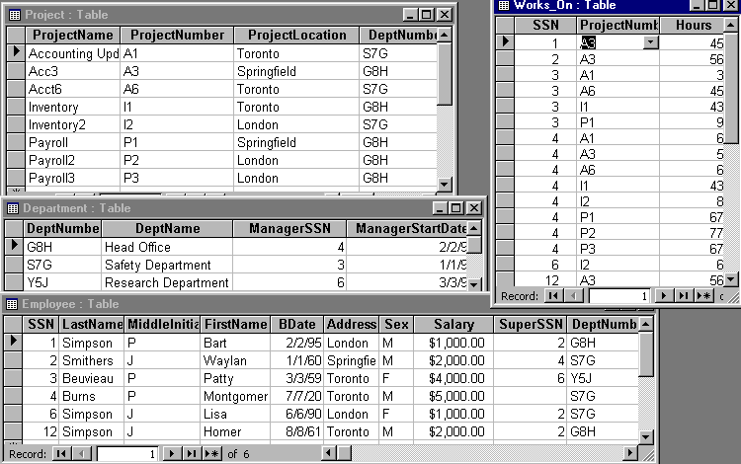
Consider…
Fred needs to know how many people worked more than 40 hours on a project
Sue needs to know who works in the London office
Homer wants to know how many supervising employees make over 2000 dollars
CS3319

